Slide 1
Multi-pathogen surveillance to guide public health action and inform policy
Respiratory Virus Genomics Workshop
8 September 2025
Jackie Kleynhans
National Institute for Communicable Diseases (NICD)
Johannesburg, South Africa
jackiel@nicd.ac.za
Slides courtesy of Sibongile Walaza

Slide 2
Surveillance main objectives
Trends in:
Incidence of influenza-like illness (ILI) and severe acute respiratory infection (SRI)
Relative contribution of important respiratory pathogens, to the syndrome of pneumonia and influenza-like illness
Estimate the burden of total and aetiology-specific ILI and pneumonia-related hospitalization and mortality in HIV-infected and -uninfected children and adults
Epidemiologic characteristics of patients with respiratory illness
Identify risk groups for severe disease
Determine the seasonality of influenza, respiratory syncytial virus (RSV) and SARS-CoV-2; and periodicity of Bordetella pertussis
Establish baseline for outbreak detection and detection of novel respiratory viruses
Infrastructure for surveillance for emerging infections – laboratory and epidemiologic
Characterize annual circulating influenza strains to guide vaccine strain selection for the southern hemisphere influenza vaccine, identify drift from the annual vaccine and identify antiviral drug resistance
Assess vaccine effectiveness for influenza, B. pertussis and SARS-CoV-2

Slide 3
Overview of respiratory syndromic surveillance programmes in South Africa
Programme | Viral Watch (ILI in private practitioners) | Influenza-like illness (ILI) | Severe respiratory illness surveillance | Digital Participatory surveillance
Type | Syndromic | Syndromic | Syndromic | Syndromic
Start year | 1984 | 2012 | 2009 | 2022- Pilot 2024 - Implementation
Provinces | EC, FS, GP, LP, KZ, MP, WC, NW, NC | KZ, NW, WC, MP | GP, KZ, MP, NW, WC, EC | EC, FS, GP, KZN, LP, MP, WC, NW, NC
Type of site | General practitioners (Private) | Primary health care clinics | Public hospitals | General public
Sampling | Not systematic | Systematic, Monday-Friday | Systematic, Monday-Friday | Weekly surveys
Specimens collected | Nasopharyngeal swab/mid-turbinate nasal | Nasopharyngeal swab/mid-turbinate nasal | Nasopharyngeal swab/mid-turbinate nasal | N/A
Pathogens | Influenza, RSV, SARS-CoV-2 | Influenza, RSV, Bordetella pertussis, SARS-CoV-2 | Influenza, RSV, Bordetella pertussis, SARS-CoV-2 | N/A
Funding | National department of health (NDoH) | NDoH and grant funds | NDoH and grant funds | Grant funds
ILI: Influenza-like illness, EC: Eastern Cape; FS: Free State; GP: Gauteng; KZ: KwaZulu-Natal; LP: Limpopo; MP: Mpumalanga: NC: Northern Cape; NW: North West; WC: Western Cape, RSV: respiratory syncytial virus; SARS-CoV-2: severe acute respiratory syndrome coronavirus-2

Slide 4
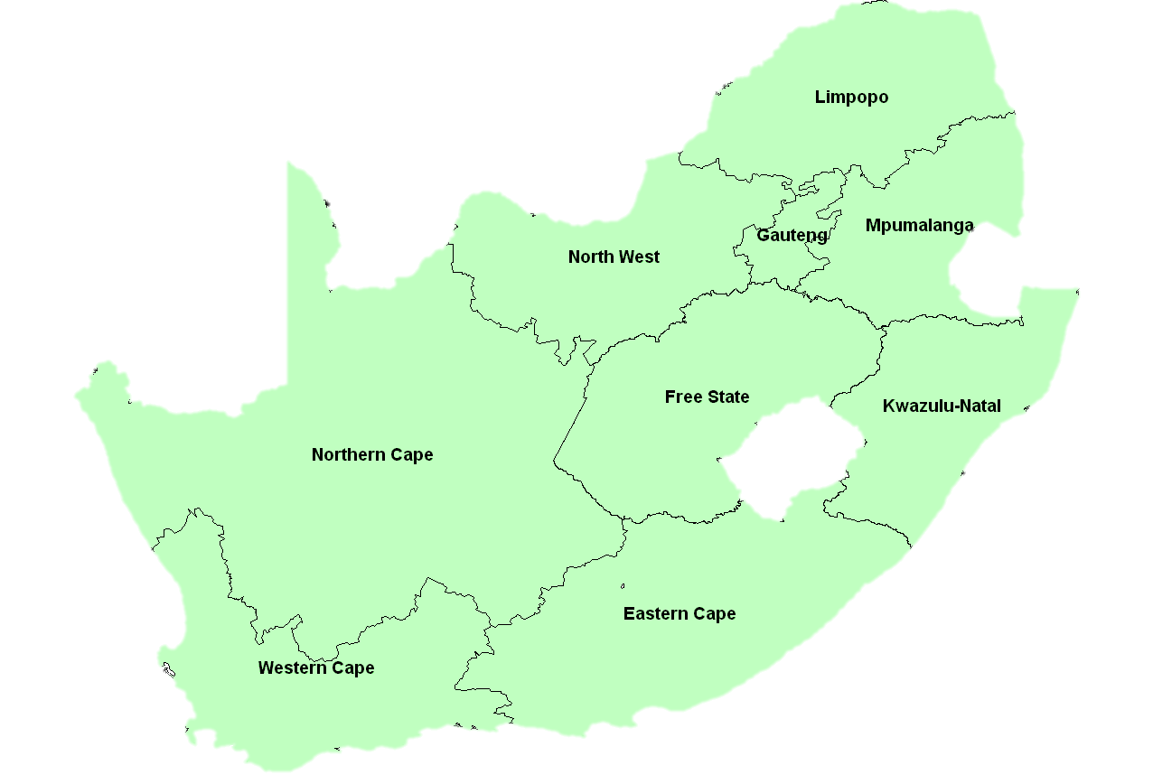
Sentinel syndromic surveillance coverage
Middle income
Temperate climate
HIV prevalence 18% in ≥ 15 years in 2021
7.5 million living with HIV in 2021
~ 328 000 (range 230 000 - 444 000) new TB cases in 2020
Lesotho
Viral Watch-ILI in private practitioners
Severe respiratory illness surveillance (SRI) in public sector hospitals
Influenza-like illness (ILI) in primary care facilities

Slide 5
Case definitions for the national syndromic surveillance for pneumonia and influenza-like illness
Case definition | Criteria
Severe respiratory illness | 2 days-<3 months Any child hospitalised with diagnosis of suspected sepsis or physician diagnosed lower respiratory tract infection (LRTI) irrespective of signs and symptoms
 | 3 months-<5 years Any child ≥3 months to <5 years hospitalised with physician-diagnosed LRTI including bronchiolitis, pneumonia, bronchitis and pleural effusion.
 | ≥5 years Any person hospitalised with an acute respiratory infection with fever (≥38°C) or history of fever AND cough
Influenza-like illness | Any person presenting with an acute respiratory infection with fever (≥38°C) or history of fever AND cough
Suspected pertussis | <1 year: apnoea All ages: a cough of any duration with at least one of the following signs and symptoms: 1. paroxysmal cough; 2. inspiratory whoop; 3. post-tussive vomiting

Slide 6
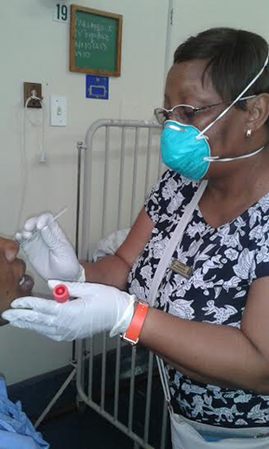
Patient enrolment and testing
Dedicated staff apply case definition
Screening:
Medical admission wards
Outpatient clinics
Informed consent
Interview and medical record review
Demographics, presentation, underlying conditions, progression of illness, outcome
Specimen collection and testing
Nasopharyngeal swab/mid-turbinate nasal swab
Respiratory syncytial virus (RSV), influenza, B.pertussis
SARS-CoV-2 from March 2020
Testing by multiplex – real time reverse transcription polymerase chain reaction (rRT-PCR)
Variants of SARS-CoV-2 positive cases determined by whole genome sequencing or variant PCR
HIV tested as part of clinical care

Slide 7
Influenza seasons, surveillance for severe respiratory illness, South Africa 2016-2023
Notes:
Including all ages

Slide 8
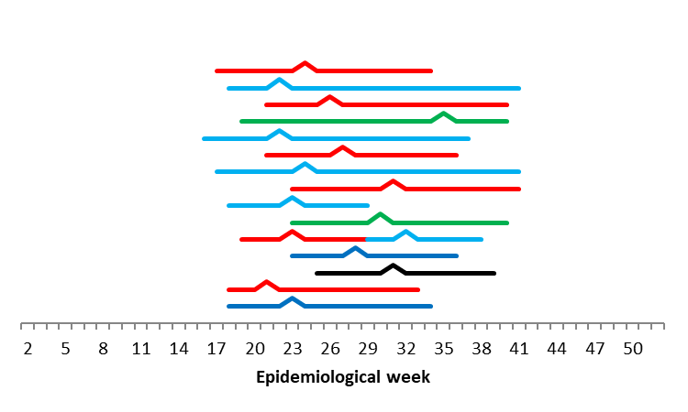
Influenza seasons, South Africa 2005-2019
Mean onset:
Week 17 (3rd week of April)
Range 16-25
2019
2018
2017
2016
2015
2014
Mean peak:
Week 23 (1st week of June)
Range 20-32
2013
2012
2011
2010
2009
2008
2007
Mean duration:
17 weeks
Range 12- 25
2006
2005
Notes:
Highly seasonal in temperate areas, Before COVID-19 In SA, The mean onset of influenza season in South Africa in 2005-2019 was week 17 (3rd week of April), ranging from week 16 to week 25
Different colours represent predominant strain circulating that year
Mean peak week 23
Season duration 12-25 weeks,

Slide 9
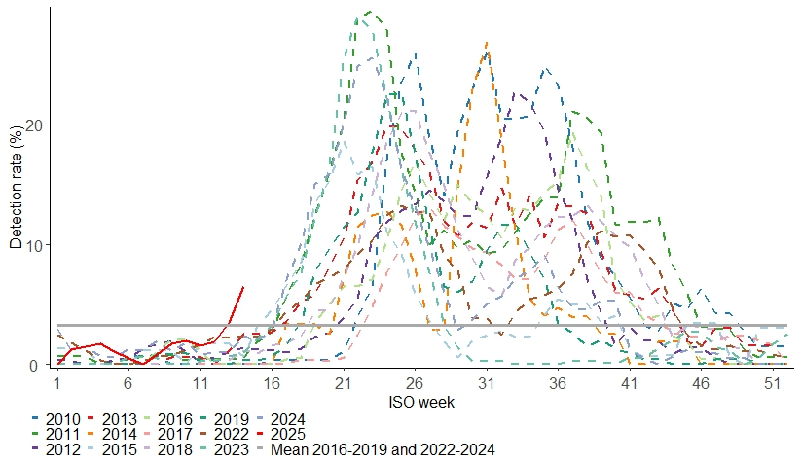
Annual influenza circulation (detection rate) in all ages, pneumonia surveillance in public hospitals, 1 January 2010 to 06 April 2025, South Africa.

Slide 10
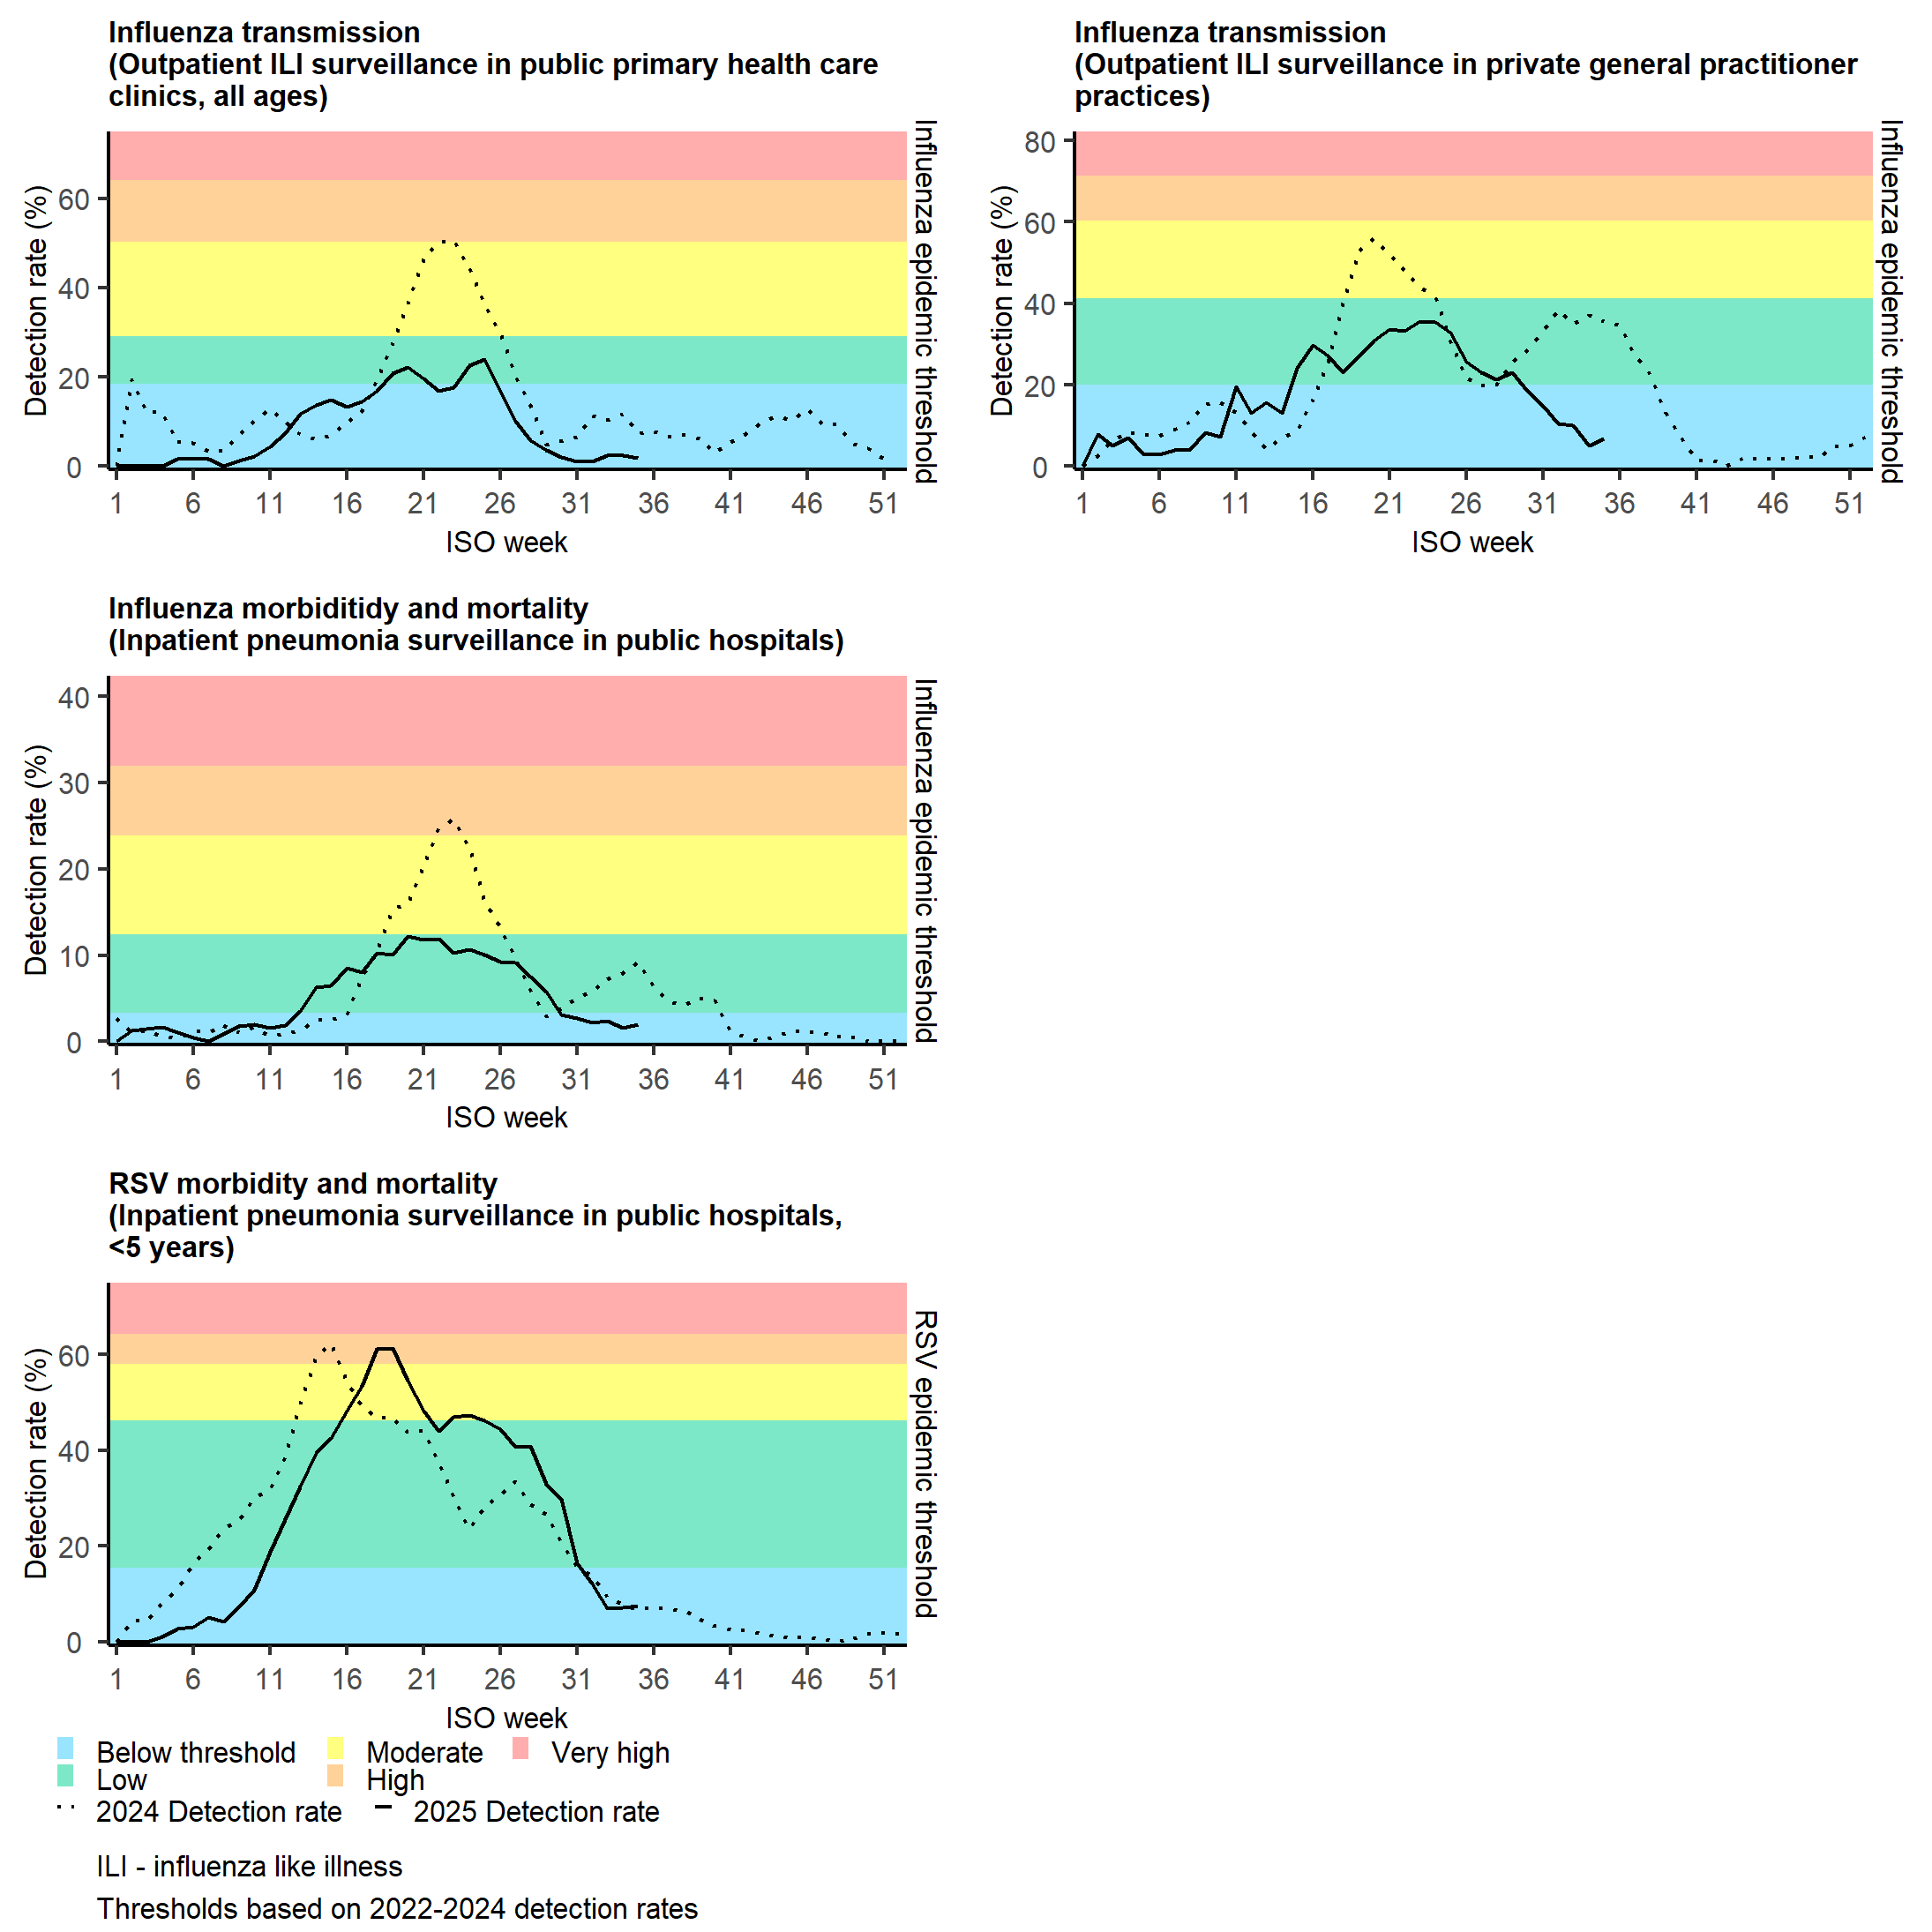
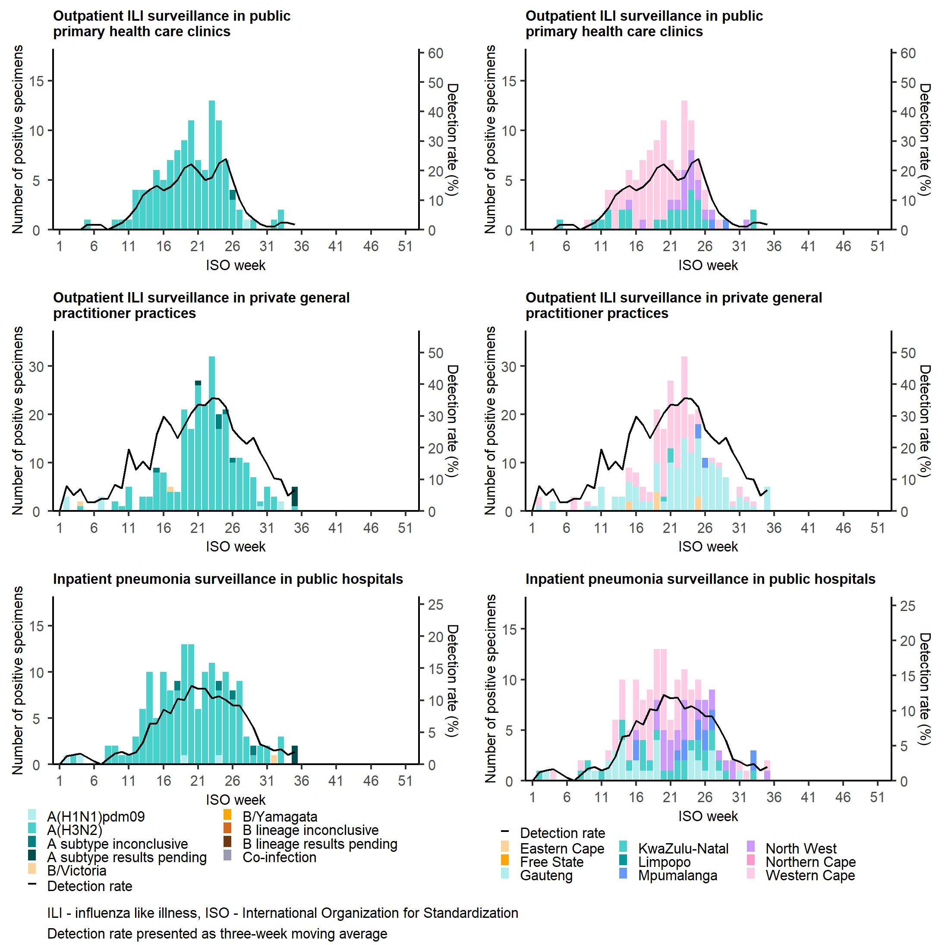
Number of laboratory-confirmed influenza cases and detection rate by subtype and lineage (left) and province (middle) and epidemic thresholds (right) in all ages, inpatient sentinel surveillance, South Africa, 30 December 2024 to 31 August 2025
The influenza season started in week 13 (week starting 24 March 2025), peaked in week 20 (week starting 12 May 2025) and ended in week 30 (week starting 21 July 2025).
The season began earlier than in the previous years, and throughout the season, the detection rate remained within the low threshold.
Influenza A(H3N2) was the most prevalent subtype detected

Slide 11
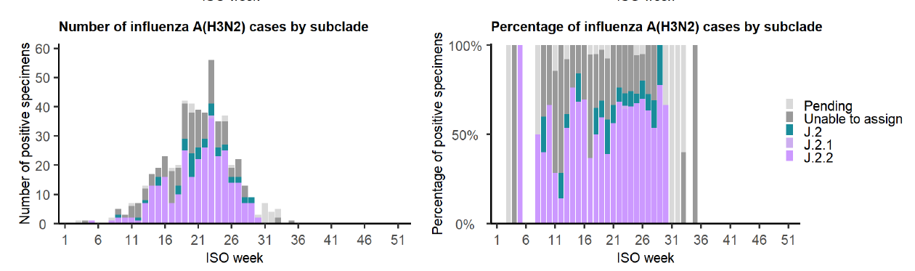
Combined number and percentage of influenza cases by subclade in all ages from three sentinel surveillance systems: outpatient influenza-like illness (ILI) surveillance in public primary health care clinics, outpatient ILI surveillance in private general practitioner practices, and inpatient pneumonia surveillance in public hospitals, South Africa, 30 December 2024 to 31 August 2025

Slide 12
Risk factors for influenza-associated severe acute respiratory illness hospitalization among children <5 years of age, 2012–2015
Variables | Influenza-Associated ILI n/N (%) | Influenza-Associated SARI n/N (%) | Adjusted Odds Ratio (95% CI) | p-value
Age (in months)
<6 | 12/149 (8.0) | 16/73 (21.9) | 5.8 (2.2-15.2) | <0.001
6-11 | 15/149 (10.1) | 17/73 (23.3) | 4.7 (1.9-11.8) | 0.001
12-23 | 31/149 (20.8) | 21/73 (28.8) | 3.0 (1.3-6.9) | 0.008
24-59 | 91/149 (61.1) | 19/73 (26.0) | Reference | -
Asthma | 0/145 (0.0) | 6/73 (8.2) | 22.7 (2.8-∞) | 0.002
Malnutrition | 16/135 (11.8) | 21/73 (28.8) | 2.4 (1.1-5.6) | 0.039
Prematurity | 4/147 (2.7) | 8/73 (10.9) | 4.8 (1.1-21.6) | 0.038
HIV | 6/145 (4.1) | 7/70 (10.0) | 3.1 (1.2-8.1) | 0.031
S. pneumoniae
Not colonized | 65/149 (43.6) | 18/73 (24.7) | 1.1 (0.4-2.8) | 0.817
Colonized (<1,000) | 55/149 (36.9) | 11/73 (15.1) | Reference | -
Colonized (≥1,000) | 29/149 (19.5) | 44/74 (60.3) | 5.5 (2.2-13.7) | <0.001
Tempia S et al, OFID 2017

Slide 13
Vaccine coverage and vaccine effectiveness (VE) by subtype and age group, Viral Watch Surveillance Programme, South Africa, 24 March – 27 July 2025
 | Vaccine coverage |  |  | Adjusted VE % (95% confidence interval)*
 | Cases n/N (%) | Controls n/N (%) | Total n/N (%)
All specimens
Any influenza | 4 / 216 (1.9) | 22 / 552 (4) | 26 / 768 (3.4) | 51.3 (-31.3 - 86)
A(H3N2) | 4 / 208 (1.9) | 22 / 554 (4) | 26 / 762 (3.4) | 49.3 (-36.9 - 85.5)
Children aged <18 years
Any influenza | 1 / 62 (1.6) | 2 / 102 (2) | 3 / 164 (1.8) | 9 (-899.7 - 95.9)
A(H3N2) | 1 / 59 (1.7) | 2 / 102 (2) | 3 / 161 (1.9) | 3.9 (-960.3 - 95.7)
Adults aged 18 – 64 years
Any influenza | 3 / 146 (2.1) | 18 / 384 (4.7) | 21 / 530 (4) | 55.8 (-35.1 - 89.8)
A(H3N2) | 3 / 141 (2.1) | 18 / 386 (4.7) | 21 / 527 (4) | 53.9 (-40.8 - 89.4)
Adults aged ≥65 years
Any influenza | 0 / 0 (0) | 2 / 74 (2.7) | 2 / 74 (2.7)
A(H3N2) | 0 / 0 (0) | 2 / 74 (2.7) | 2 / 74 (2.7)
*Adjusted for timing within season (early, mid, late) and age
VE was assessed using a test-negative case control study design
Viral Watch outpatient influenza sentinel surveillance programme (N=768)

Slide 14
Vaccine coverage and vaccine effectiveness (VE) by subtype and age group, Viral Watch Surveillance Programme, South Africa, 22 April-18 August 2024
 | Vaccine coverage |  |  | Adjusted VE % (95% confidence interval)*
 | Cases n/N (%) | Controls n/N (%) | Total n/N (%)
All ages
Any influenza | 5/251 (2.0) | 23/254 (9.1) | 28/505 (5.5) | 74.7 (30.9; 90.7)
A(H1N1)pdm09 | 4/197 (2.0) | 23/254 (9.1) | 27/451 (6.0) | 69.6 (5.3; 90.2)
Children aged <18 years
Any influenza | 0/71 (0.0) | 4/62 (6.5) | 4/133 (3.0) | 84.0 (-223.3; 99.2)
A(H1N1)pdm09 | 0/51 (0.0) | 4/62 (6.5) | 4/113 (3.5) | 71.1 (-504.3; 98.6)
Adults aged 18 – 64 years
Any influenza | 5/164 (3.0) | 18/171(10.5) | 23/335 (6.9) | 69.4 (14.0; 89.1)
A(H1N1)pdm09 | 4/131 (3.1) | 18/171 (10.5) | 22/302 (7.3) | 63.9 (-16.5; 88.8)
Adults aged ≥65 years
Any influenza | 0/16 (0.0) | 1/21 (4.8) | 1/37 (2.7) | 40.0 (-1998.1; 98.3)
A(H1N1)pdm09 | 0/15 (0.0) | 1/21 (4.8) | 1/36 (2.8) | 40.0 (-1998.1; 98.3)
*Adjusted for timing within season (early, mid, late) and age
VE was assessed using a test-negative case control study design
Viral Watch outpatient influenza sentinel surveillance programme (N=505)
Notes:
VE assessed using a test negative case control study design
505 cases in VE analysis, 251 (49.7%) classified as cases (influenza test positive) and 254 (50.3%) as controls
Vaccine coverage low, 5.5% overall

Slide 15
Incidence rates, incident rate ratios and case-fatality ratios among children <6 months of age hospitalised with influenza-associated severe acute respiratory illness (SARI), in Soweto, South Africa, 2010-2011
Organism | Incidence rates per 100 000 population | Incidence rate ratio (IRR) | CFR n/N (%) | OR
HUU | 412 (325-515) | Reference | 1/64 (2) | Reference
HEU | 503 (354-693) | 1.4 (1.3-1.5) | 2/33 (6) | 4.1 (0.4-46.6)
HIV infected | 2516 (1300-4394) | 3.8 (3.3-5.5) | 2/10 (20) | 15.8 (1.3-193.9)
HUU – HIV unexposed uninfected, HEU – HIV exposed uninfected, HI – HIV infected
CI – confidence interval
Cohen C et al Pediatrics 2016
Notes:
We described the epidemiology of LRTI hospitalization in HIV-unexposed uninfected (HUU) and HEU infants aged <6 months in South Africa. Looked at Epidemiology of Acute Lower Respiratory Tract Infection in HIV-Exposed Uninfected Infants.
The annual incidence of LRTI was elevated in HEU (incidence rate ratio [IRR] 1.4; 95% confidence interval [CI] 1.3–1.5) and HIV infected (IRR 3.8; 95% CI 3.3–4.5), compared with HUU infants

Slide 16
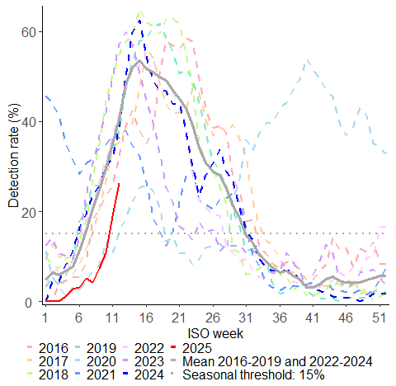
Respiratory syncytial virus (RSV) circulation in children aged <5 years, pneumonia surveillance, South Africa, 2016 to 23 March 2025

Slide 17
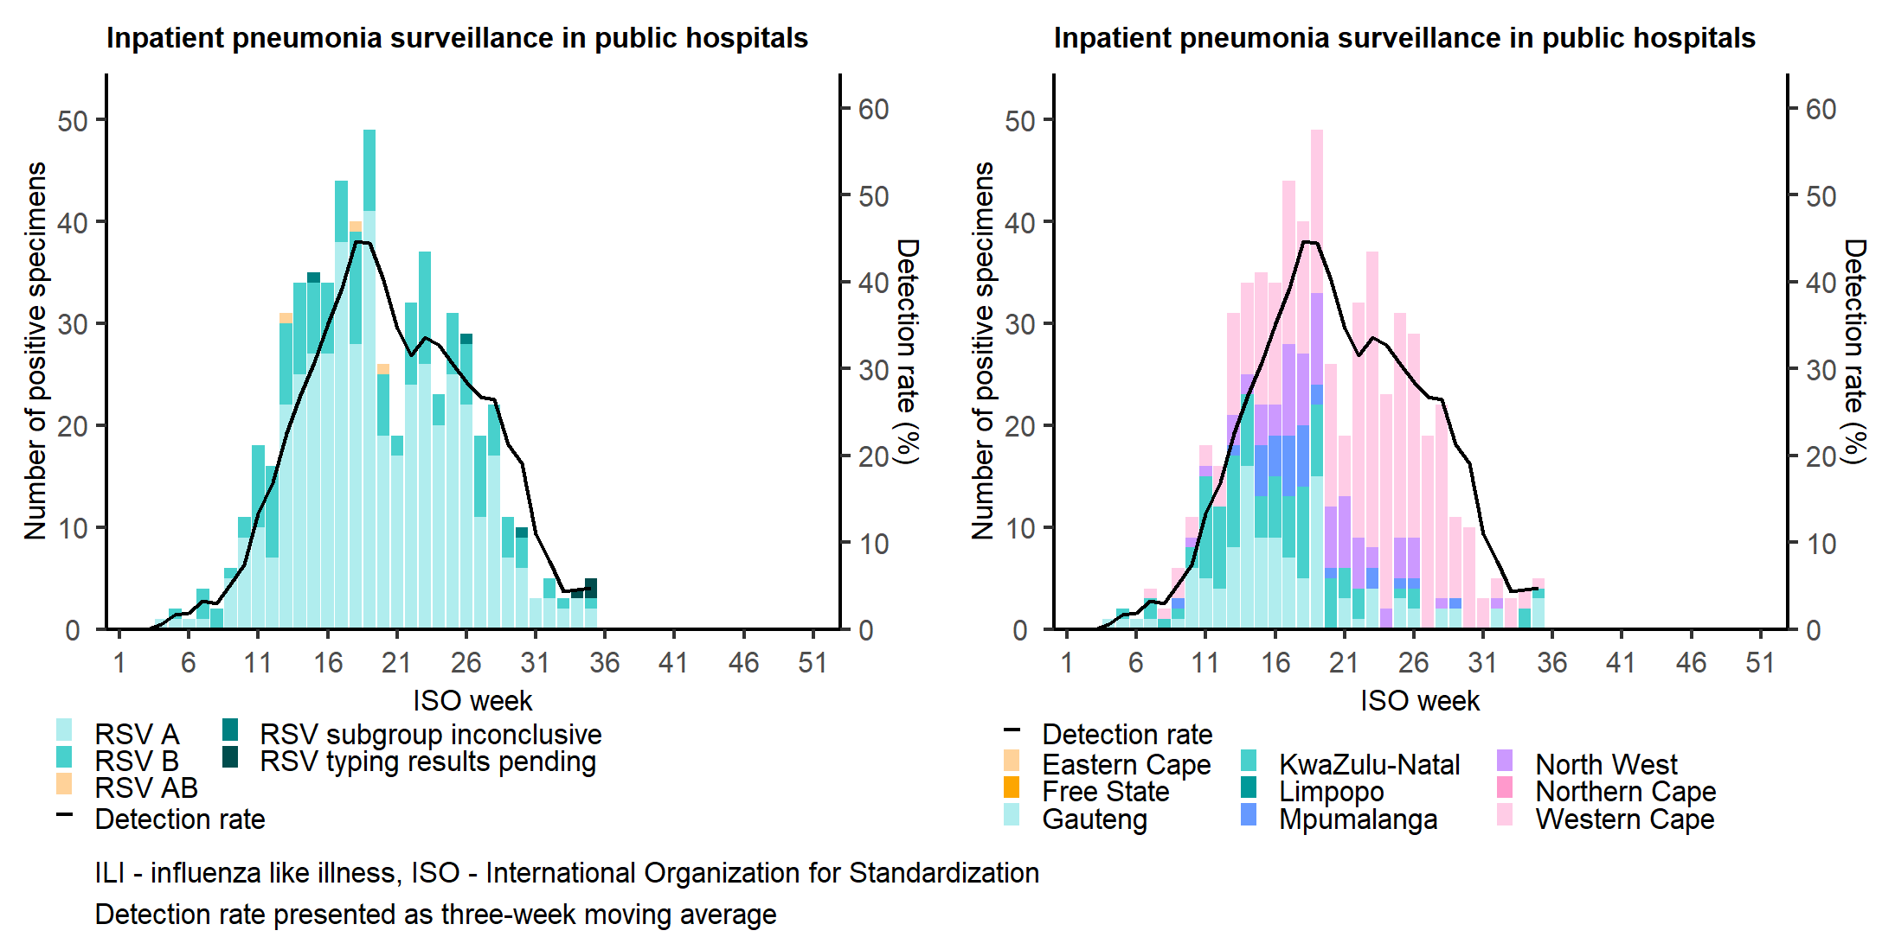
Number of laboratory-confirmed respiratory syncytial virus (RSV) cases and detection rate by type (left) and province (middle) in all ages, and epidemic thresholds in children <5 years (right) from inpatient sentinel surveillance, South Africa, 30 December 2024 to 31 August 2025.
The RSV season started in week 11 (week starting 10 March 2025), peaked in week 16 (week starting 15 April 2025 at the moderate level, and ended in week 31 (week starting 28 July 2025).

Slide 18
RSV detections and epidemic thresholds among all age groups (A) and among children aged <5 years, severe respiratory illness surveillance in public sector hospitals, 2017-2022
A-All ages
B-Children < 5 years
Thresholds based on 2010-2016 data
Notes:
During COVID-19, higher numbers in adults affected thresholds for the start and intensity of RSV season
Previously were using individuals of all ages to calculate the seasonal thresholds, however as COVID-19 mostly affecting adults than children the RSV detection rates were much lower and if we’d continued to use all ages we’d have missed the increase in RSV following the relaxation of restrictions and return of children to school.

Slide 19
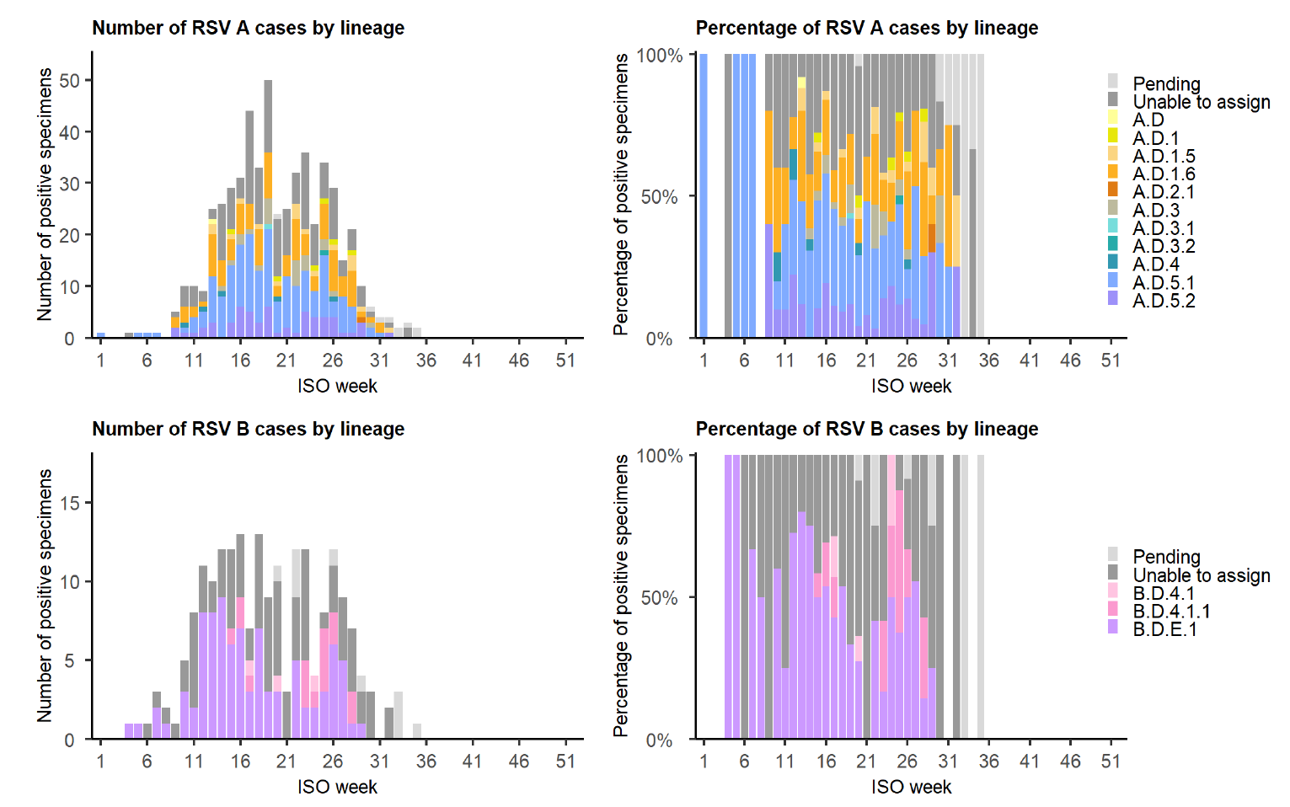
Combined number and percentage of RSV cases by lineage in all ages from three sentinel surveillance systems: outpatient influenza-like illness (ILI) surveillance in public primary health care clinics, outpatient ILI surveillance in private general practitioner practices, and inpatient pneumonia surveillance in public hospitals, South Africa, 30 December 2024 to 31 August 2025

Slide 20
Factors associated with RSV-associated hospitalization among children <5 years of age, at two sites, South Africa, 2012–2018
J Moyes
Variables | RSV-associated ILI n/N (%) | RSV-associated SARI n/N (%) | Univariate analysis |  | Multivariable analysis
 |  |  | Odds ratio (95% CI) | p | Adjusted odds ratio (95% CI) | p
 | N=317 (DR=11%) | N=762 (DR=25%)
Age (in months)
<2 | 9/317 (3) | 190/762 (25) | 40.7 (19.3–85.6) | <0.001 | 54.4 (23.5–125.8) | <0.001
2 | 18/317 (6) | 92/762 (12) | 9.9 (5.4–17.9) | <0.001 | 12.0 (6.2–23.1) | <0.001
3–5 | 40/317 (13) | 176/762 (23) | 8.5 (5.3–13.6) | <0.001 | 9.6 (5.8 –16.0) | <0.001
6–11 | 73/317 (23) | 145/762 (19) | 3.8 (2.5–5.9) | <0.001 | 4.0 (2.5–6.4) | <0.001
12–23 | 71/317 (25) | 104/762 (14) | 2.8 (1.8–4.4) | <0.001 | 3.1 (1.9–5.1) | <0.001
24–59 | 106/317 (33) | 55/762 (7) | Reference |  | Reference
Any underlying medical condition¹ | 46/316 (15) | 197/762 (26) | 2.0 (1.4–2.9) | <0.001
Malnutrition | 25/305 (8) | 119/757 (16) | 2.1 (1.3–3.3) | <0.001 | 1.9 (1.2–3.2) | 0.014
Prematurity<37 weeks (vs ≥37 weeks) | 15/316 (5) | 91/762 (12) | 2.7 (1.6–4.8) | <0.001 | 2.4 (1.3–4.6) | 0.007
HIV infection | 2/304 (1) | 25/725 (4) | 5.4 (1.3–22.9) | 0.004 | 22.5 (2.9–174.3) | 0.003
Notes:
RSV detection rate 11% (317/2770) for those with ILI and 25% (762/3016) in patients with SARI
Highest detection rate in < 6 months, 36%, (458/1276) and in the 6–11 month age group for children with ILI 14% (73/517)

Slide 21
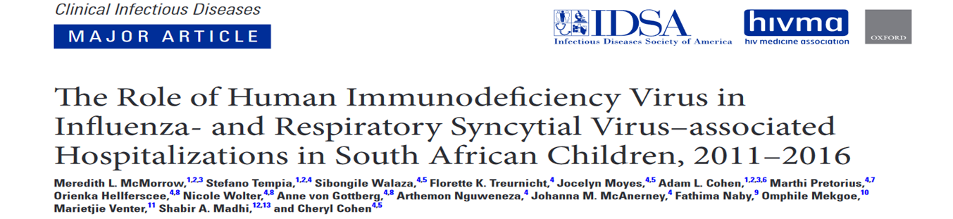
5.6% positive for influenza, 23.9% for RSV
Median age of children hospitalized with influenza= 13.9 months vs 4.4 months for RSV (P < .01)
RSV-associated hospitalization rates higher than influenza-associated hospitalization rates in the first 2 years of life
Annual influenza-associated hospitalization rates highest in 6–11 months (545; 95% confidence interval [CI],409–703),RSV-associated hospitalization rates highest in 0–2 months (6593; 95% CI, 5947–7217)
HIV exposure and HIV infection are risk factors for influenza- and RSV-associated hospitalization.
Notes:
Exposure in 0-5 months and HIV risk factor for

Slide 22
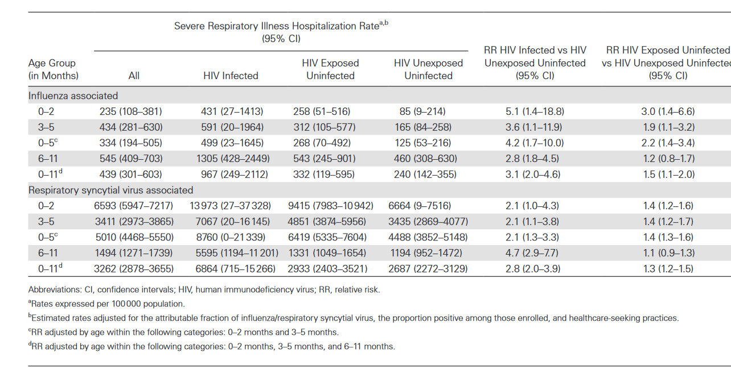
Estimated Mean Annual Rates of and Relative Risk Associated With Human Immunodeficiency Virus (HIV) Infection and HIV Exposure for Influenza- or Respiratory Syncytial Virus–associated Severe Respiratory Illness Hospitalization in Infants Aged 0–11 Months, Klerksdorp and Pietermaritzburg, South Africa, 2011–2016
McMorrow, CID
Notes:
In this work we looked at the role of HIV in influenza and RSV-associated hospitalizations in South African children. estimated rates of influenza- and RSV-associated hospitalized SRI by human immunodeficiency virus (HIV) status and compared children who tested positive for influenza vs RSV

Slide 23
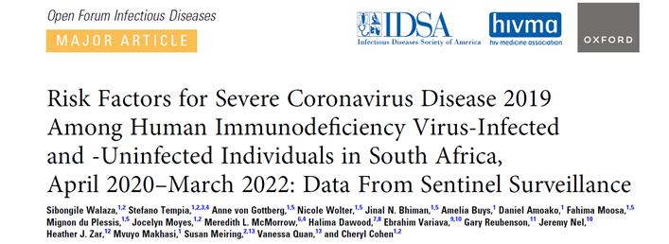
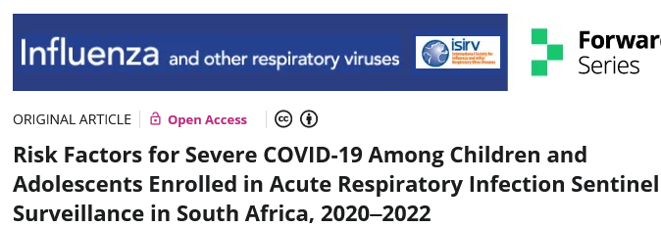
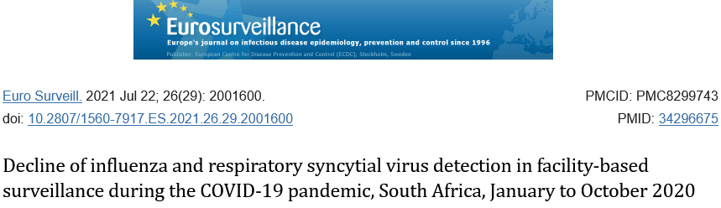
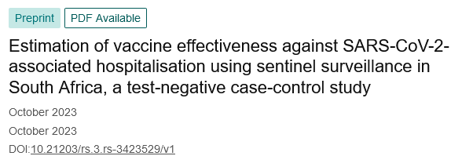
Using surveillance data to respond to SARS-CoV-2 pandemic
Similar trends of circulating variants in national laboratory–based and sentinel surveillance
National genomic surveillance of South Africa (NGSA)
Sentinel surveillance
Number of SARS-CoV-2 genomes and detection rate* by specimen collection week, National genomic surveillance and syndromic sentinel surveillance**, South Africa, 1 March 2020 – 5 March 2022
*Detection rate = proportion of SARS CoV-2 tests that are positive; **syndromic sentinel surveillance = SRI and ILI

Slide 24
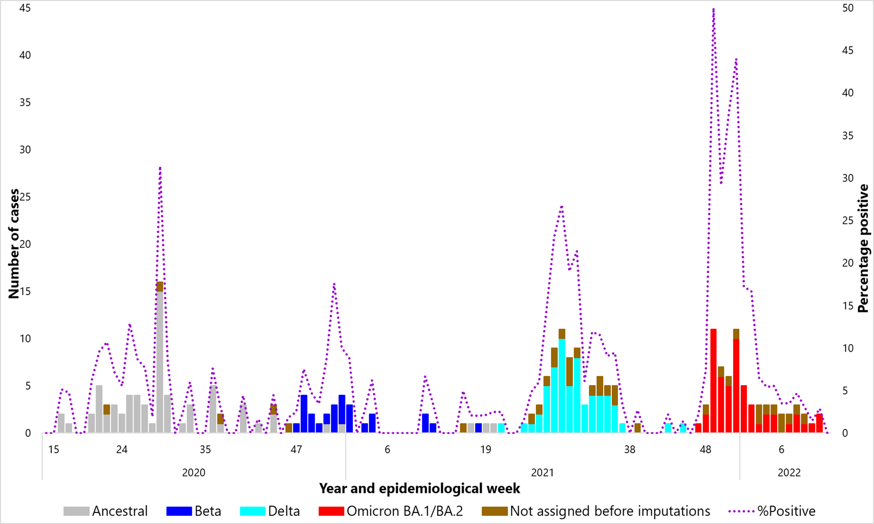
Number of SARS-CoV-2 cases among children aged ≤18 years by variant and percentage positive by epidemiological week, April 2020-March 2022
K Jensen, IORV 2024

Slide 25
COVID-19 changed health seeking behaviour and affected admission numbers in facility –based surveillance
Influenza-like illness (ILI)
Severe respiratory illness (SRI)
A (<1 year)
B (1-4 years)
A (<1 year)
B (1-4 years)
C (5-19 years)
D (20-44 years)
C (5-19 years)
D (20-44 years)
E (45-64 years)
F (≥65 years)
E (45-64 years)
F (≥65 years)
Tempia et al, Eurosurveillance 2021
The blue vertical line (week 12) indicates the start of SARS-CoV-2 control measures in 2020.
Notes:
Dr Tempia used surveillance data

Slide 26
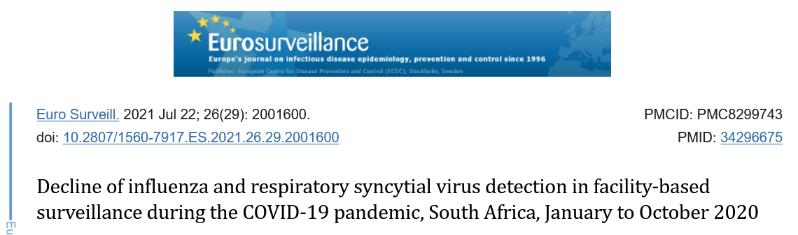
Tempia et al, 2021
A (ILI)
Influenza-like illness
A (ILI)
B (SRI)
B (SRI)
Severe respiratory illness
Notes:
SA is a temperate country , graphs on left Influenza ILI at top and SRI at bottom dotted line mean 2013-2019 influenza season in winter, Bi phasic peak for influenza
On R RSV

Slide 27
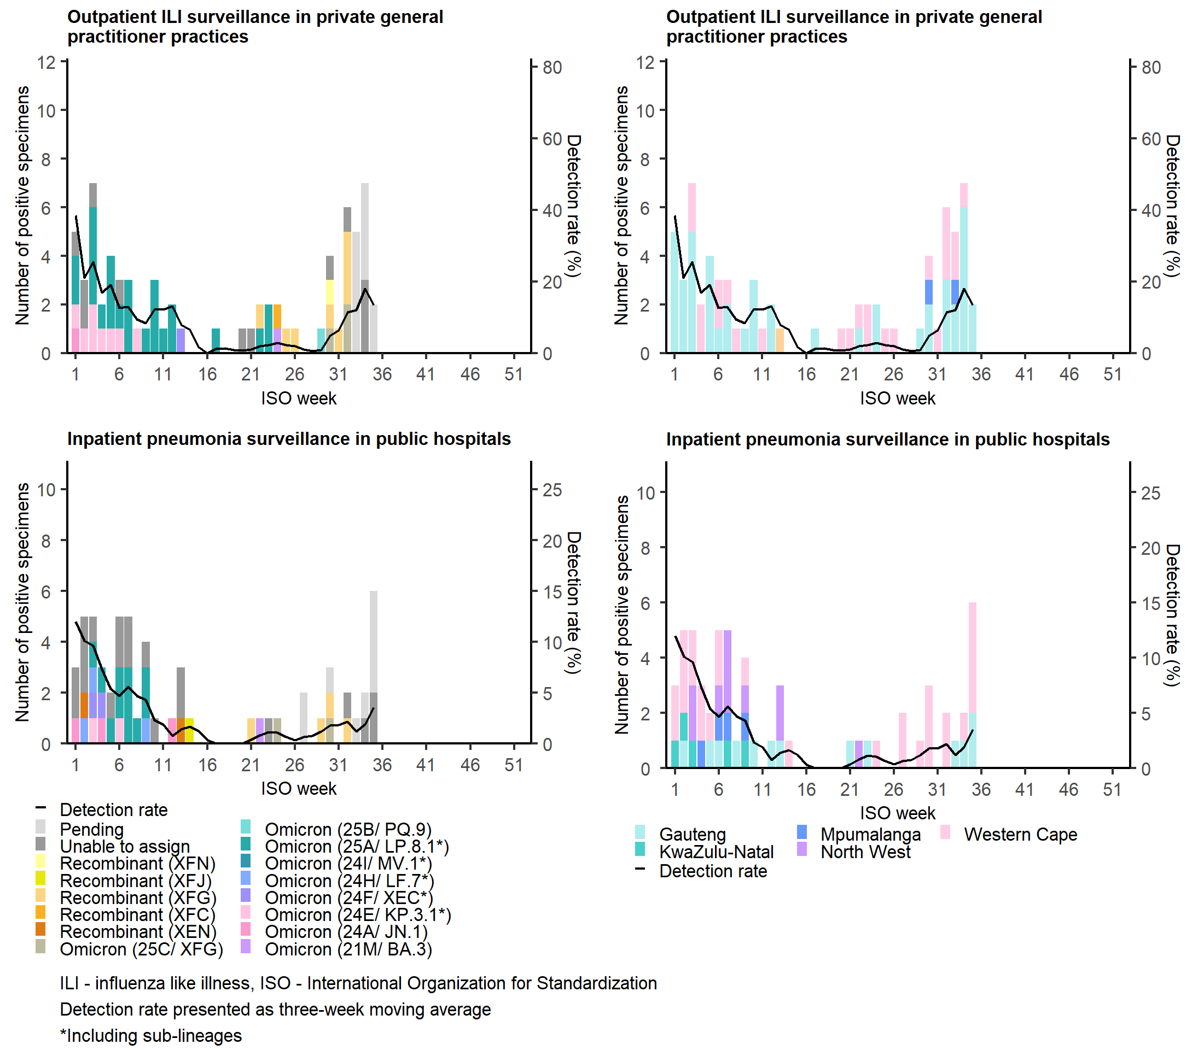
Number of laboratory-confirmed SARS-CoV-2 cases and detection rate by variant type (left) and province (right) in all ages, sentinel surveillance, South Africa, 30 December 2024 to 31 August 2025.
SARS-CoV-2 circulation has been low in 2025 so far.
An increase in SARS-CoV-2 detections has been observed in both Viral Watch (private practitioners) and pneumonia surveillance (public hospitals) in recent weeks.
Between weeks 21–32, where sequencing data are available, 35% of SARS-CoV-2 cases were the XFG recombinant variant.

Slide 28
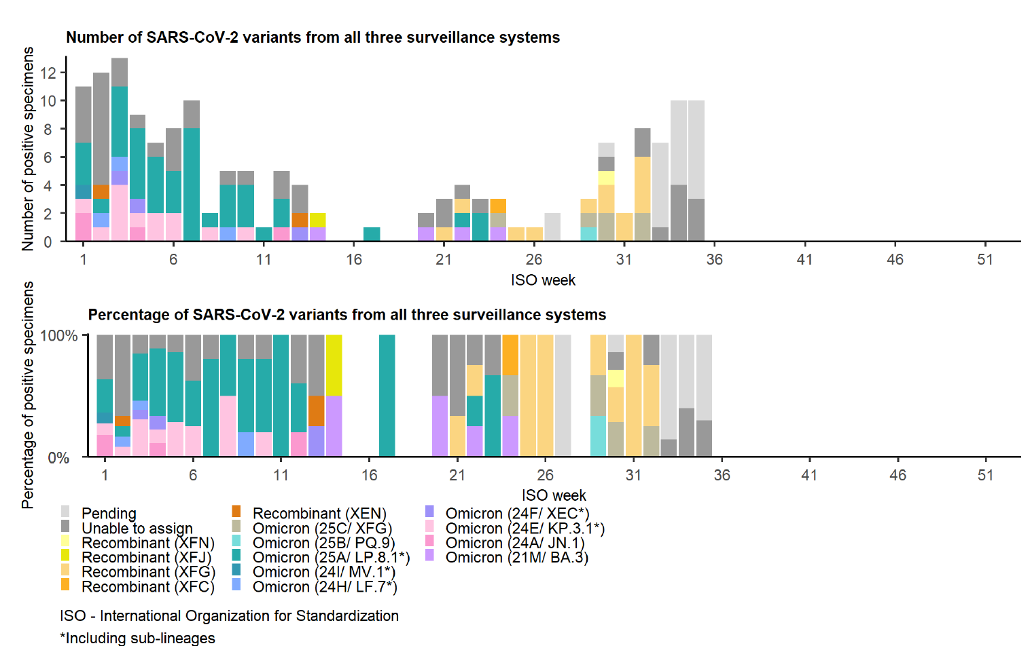
Combined number and percentage of SARS-CoV-2 variants in all ages from three sentinel surveillance systems: outpatient influenza-like illness (ILI) surveillance in public primary health care clinics, outpatient ILI surveillance in private general practitioner practices, and inpatient pneumonia surveillance in public hospitals, South Africa, 30 December 2024 to 31 August 2025

Slide 29
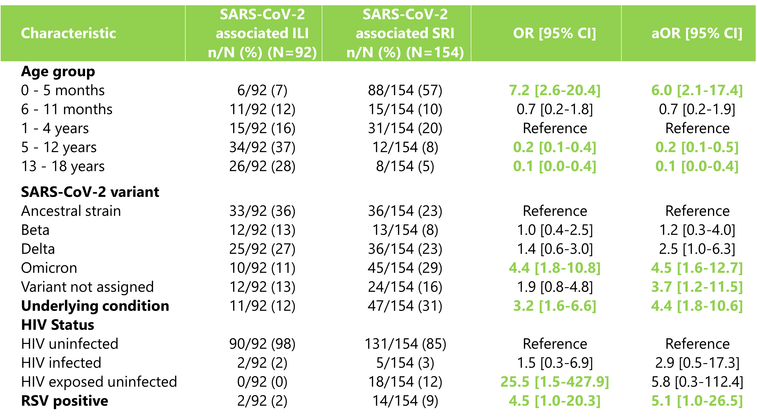
Risk factors for SARS-CoV-2 associated severe respiratory illness among individuals aged≤ 18 years, April 2020-March 2022
Kate Jensen, IORV 2024

Slide 30
Summary
Described incidence and aetiology of respiratory illness
Described risk factors for severe respiratory illness
Robust system with ability to upscale to include an emerging pathogen
robust data for tracking the SARS-CoV-2 epidemic
tracked other respiratory pathogens
systematically collected data from previous years were invaluable at start of pandemic
Data used to inform policy and public health action
Maternal pertussis vaccination
Children with underlying medical conditions included on target group for public funded influenza vaccine campaign
Data on seasonality- alerts
Groups to target for interventions
Importance of sustainable surveillance
Platform to continue monitoring SARS-CoV-2
SARS-CoV-2 testing and sequencing dropping
Future pandemics
Experience from COVID-19 extended to other pathogens (RSV and influenza sequencing)
Platform to assess interventions e.g. RSV vaccines, maternal pertussis vaccination
Challenges
Costly
Relies on active partners
Notes:
Detected community transmission of SARS-CoV-2
Waves similar to national trends
Predominant variants
Risk factors for SARS-CoV-2 associated hospitalisation
Older age, underlying medical conditions, being black compared to other races, living with HIV, prior or current TB
Limitations
Low numbers-
Residual confounding may be biasing VE estimates i.e. time varying changes in policies and testing practices
As RSV vaccines are being implemented- useful backbone to provide to track changes in epidemiology and impact of measures

Slide 31
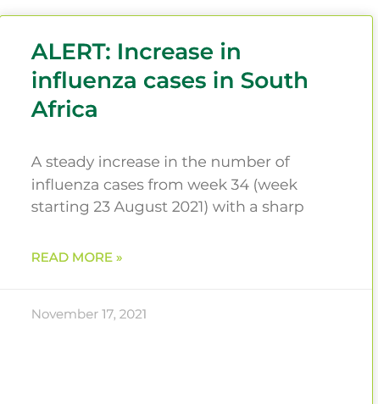
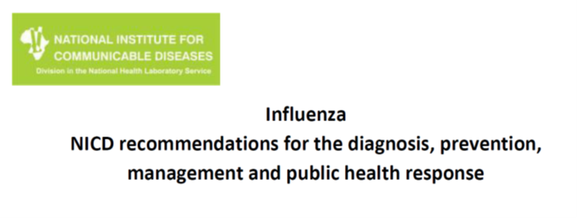

Sharing data
Annual
All available at www.nicd.ac.za

Slide 32

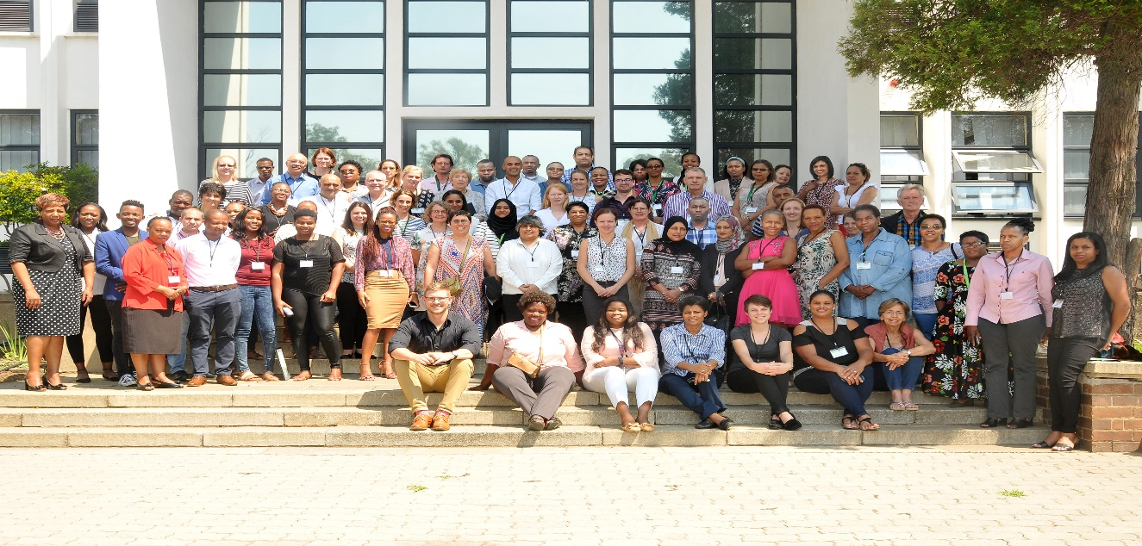
Influenza-like illness and National syndromic surveillance for pneumonia, South Africa, 2022
Surveillance Officers & Research Assistants Babalwa Magawu
Bernard Motsetse
Cecilia Miller
Charlene Isaacs
Cheryl Mentor
Chulumanco Nkosi
Elizabeth Motaung
Gift Mnisi
Godfrey Mabunda
Innocent Kweyama
Kate Bishop
Koketso Manaka
Kholiwe Mgidlana
Lerato Qoza
Lucia Nondyebo Madolo
Milliah Hlathi
Moroesi Mosepele
Myrah Moremi
Ndugiselo Muravha
Nhlakanipho Malinga
Noluthando Gamka
Nombulelo Sithebe
Nomvuyiso Yako
Nonceba Hilda Ngubo
Nondumiso Khoza
Nosisa Simanga
Nothando Mthembu
Patience Ngube
Phindile Ngema
Palesa Seutloali
Phathiswa Ranyana
Phumelelo Mavundla
Priscilla Mouton
Seipati Matshogo
Sunnieboy Njikho
Tuelo Matotong
Tshwanelo Mahloko
Vanesa Kok
Wendy Ngubane
Zanele Sewele
Zukiswa Kibi
Data Entry Team and Administrators
Boitumelo Chuene
Faakhiera Stellenboom
Robert Musetha
Shirley Mhlarhi
Judith Tshabalala,
Thembi Mthembu
Nondumiso Makabate
Mpho Ntoyi
Thelma Maswanganyi
Centre for Respiratory Diseases and Meningitis:
Alexandra Moerdyk, Amelia Buys, Anne von Gottberg, Azwifarwi Mathunjwa, Cardia Fourie, Cayla Reddy, Cheryl Cohen, Daniel Amoako, Emmanuel Phalane, Fahima Moosa, Fiada Mothapo, Hanif Carrim, Jackie Kleynhans, Jinal Bhiman, Jocelyn Moyes, Josie Everatt; Kedibone Ndlangisa, Maimuna Carrim, Mignon du Plessis, Mpilo Mabuza, Mzimasi Neti, Mvuyo Makhasi, Nicola Chiwandire, Nicole Wolter, Noluthando Duma, Linda De Gouveia, Phiwokuhle Ntombela, Retshiditswe Kotane, Sibongile Walaza, Sibusisiwe Zulu, Siyabonga Mazibuko, Stefano Tempia, Theresa Mashaba, Thulisa Mkhencele, Thulisile Nkabinde, Wesley Dlamini
Edendale Hospital: Halima Dawood, Fathima Naby, Sumayya Haffejee
Klerksdorp/Tshepong Hospital Complex: Khumo Bardman, Omphile Mekgoe, Ebrahim Variava
Rahima Moosa Mother and Child and Helen Joseph Hospitals : Ashraf Coovadia, David Spencer, Gary Reubenson , Jeremy Nel, Zodwa Kgapola
Red Cross Hospital/ Mitchell’s Plain District Hospital/ Eastridge Clinic/ Mitchell’s Plain CHC: Heather Zar
Tygerberg Hospital: Arifa Parker
Tembisa Hospital: John Mathabathe
Livingstone Hospital: John Black
Mpumalanga/Matikwana: Neydis Baute, Godfery Sewele
MRC/Wits Rural Public Health and Health Transitions Research Unit (Agincourt): Kathleen Kahn, Rhian Twine , Stephen Tollman
Centre for Disease Control and Prevention (CDC): Aaron Samuels
GERMS-SA: Mokupi Manaka, Susan Meiring, Vanessa Quan, Kate Bishop
All the patients who kindly agreed to participate in the surveillance

Slide 33


Slide 34


